Slide 1

Welcome, Habibi!
deez our presentation on:
ROLE OF HORMONES IN
COMPLETING THE LIFE CYCLE
OF FROG AND INSECTS

Slide 2
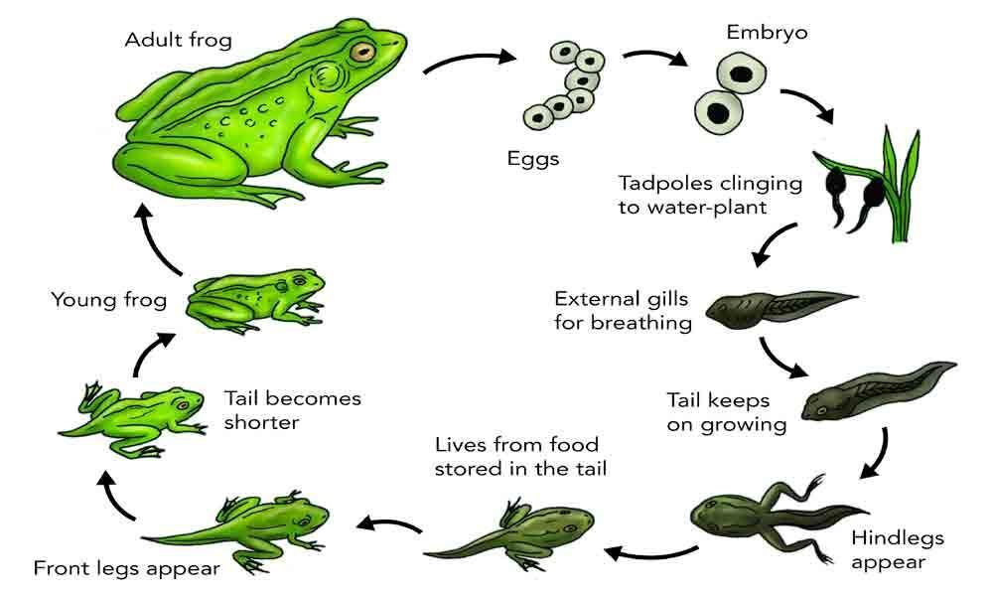

Slide 3
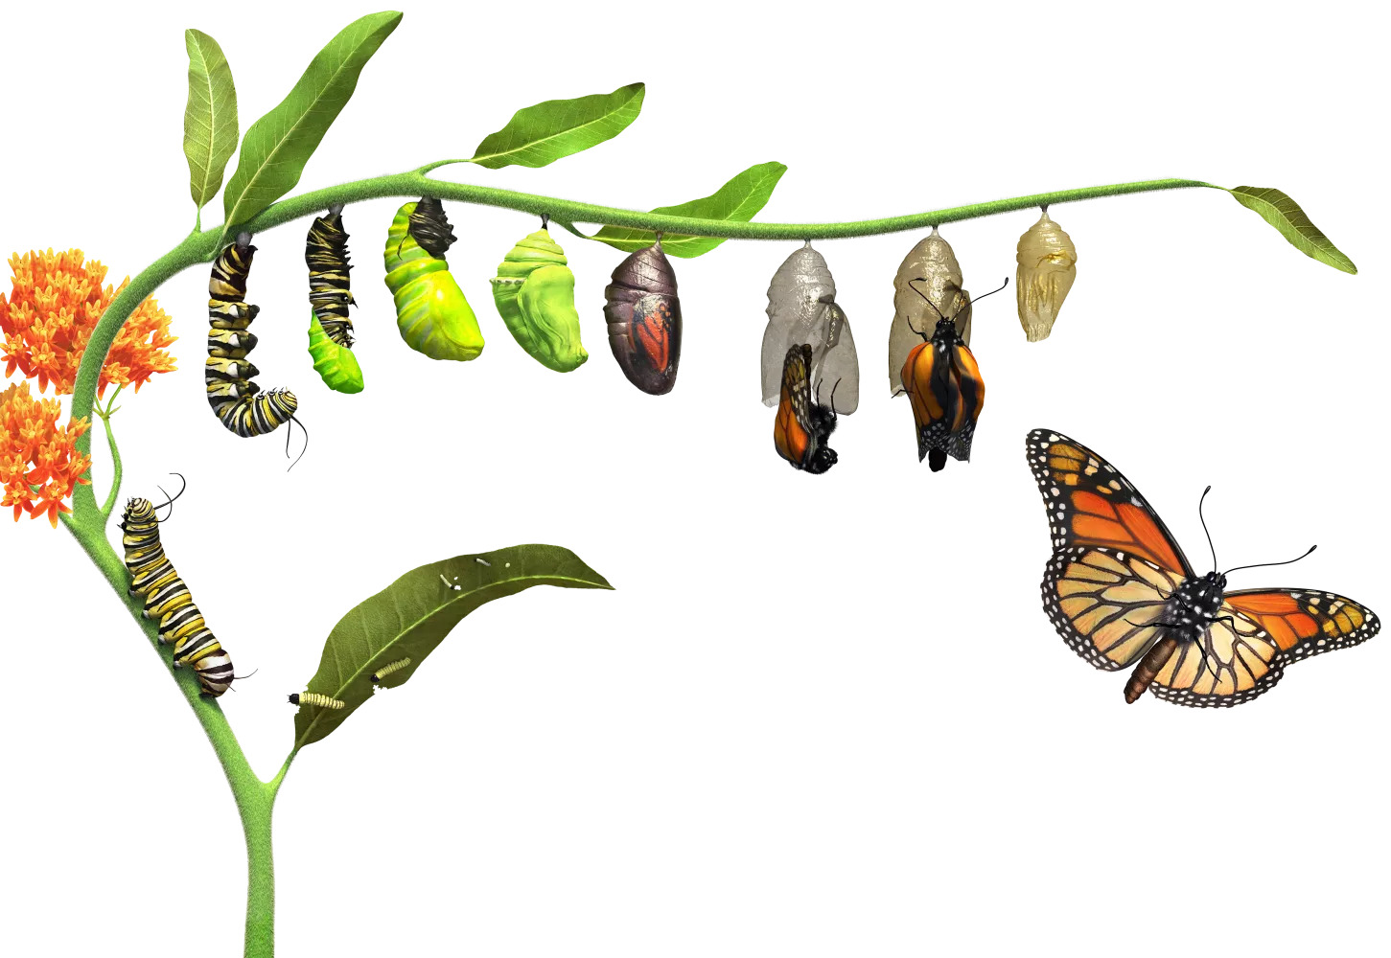

Slide 4
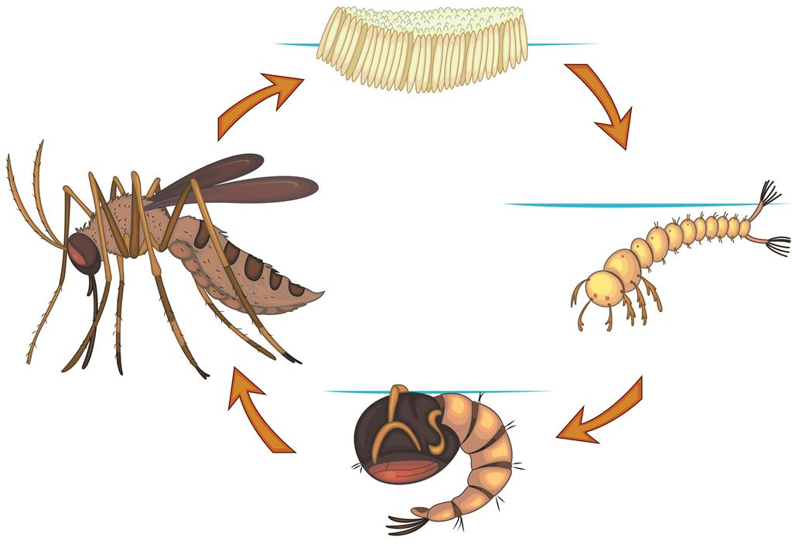

Slide 5
Thank you!
Presentation made possible by:
@TDIVYAJYOTIS Tripathy divyajyoti senapati
@SOUL_79_HYPER VIPUL BARISAL
@SOURYA_NGU SOURYA SURYANSH

